Slide 1
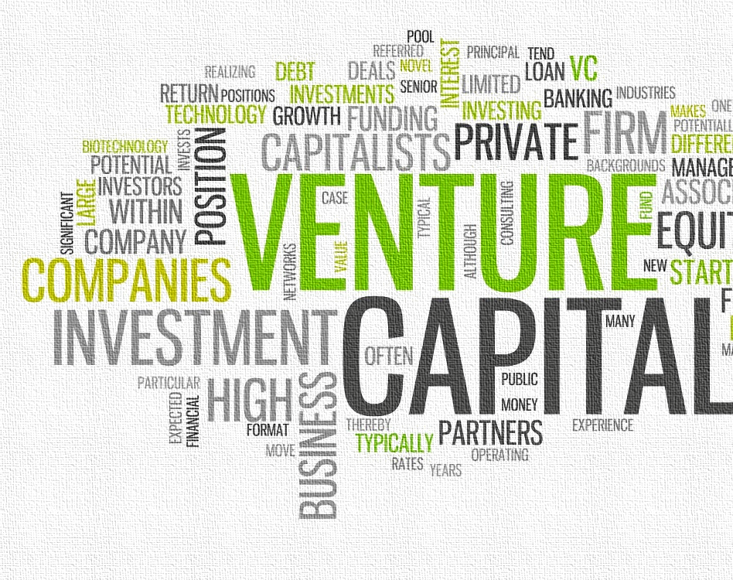
UOW ECON251 Industry and Trade in Asia Topic 5 : Foreign Investment
Part 1 :
Foreign Direct Investment and Foreign
Part 2
Portfolio investment

Slide 2
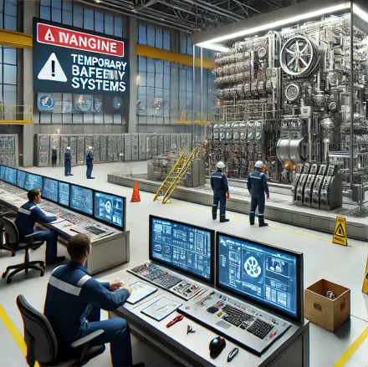
Back to basics
Capital goods (K )
Described as tools and machinery used in production of goods and services
Spending on capital goods is known as fixed capital formation .
It is expensive, thus requires funding and involves risk
More cost effective for large scaled production

Slide 3
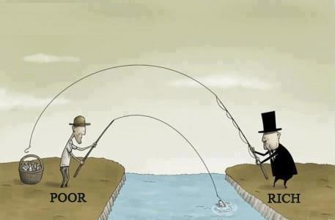
The Dependency theory
Developed Economies
Developing Economies
This Photo by Unknown Author is licensed under CC BY-SA

Slide 4
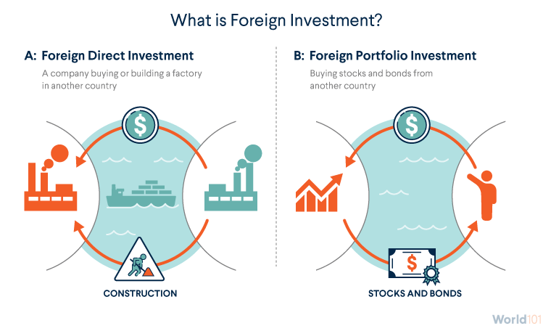
1. Introduction
Definition
Level of participation :
Wholly foreign owned
Joint venture with private entity
Joint venture with public entity
Video Link : https://youtu.be/xP3nDn_fzGQ
Image source: WPrld101.cfr.org

Slide 5
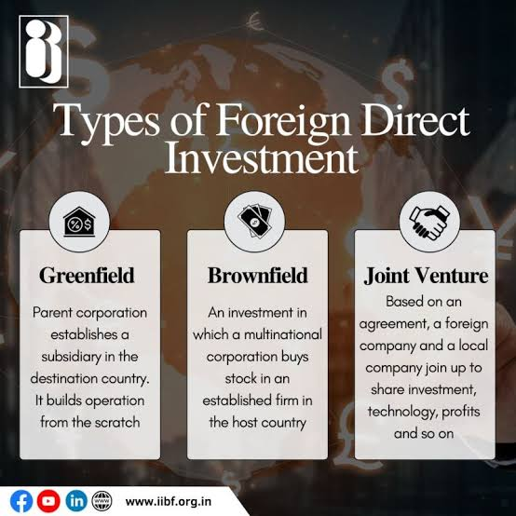
1.1 Types of FDI flows
Exercise 1
Which type of FDI will you classify for the following goods / industry
1. AI chip set
2. Electric car battery
3. Data centre
4. Pharmaceutical drugs
5. Plant based food
6. Solar panel
Which of the above may even fall under joint venture with the local government
Note whilst we tend to use the term FDI, but more specifically, we are considering FDI inflow
Greenfield
Greenfield
Greenfield
Brownfield
Brownfield
Greenfield

Slide 6

Part 1 Foreign Direct Investment (FDI) Key focus

Slide 7
Overview
Primary industry
Low K, High L
Poor performance
Manufacturing
Higher K
Sustained growth
Outward Oriented Growth
Increase exports
Late comer : hard to compete
Infant industry
Existing firms :
MNCS :

Slide 8
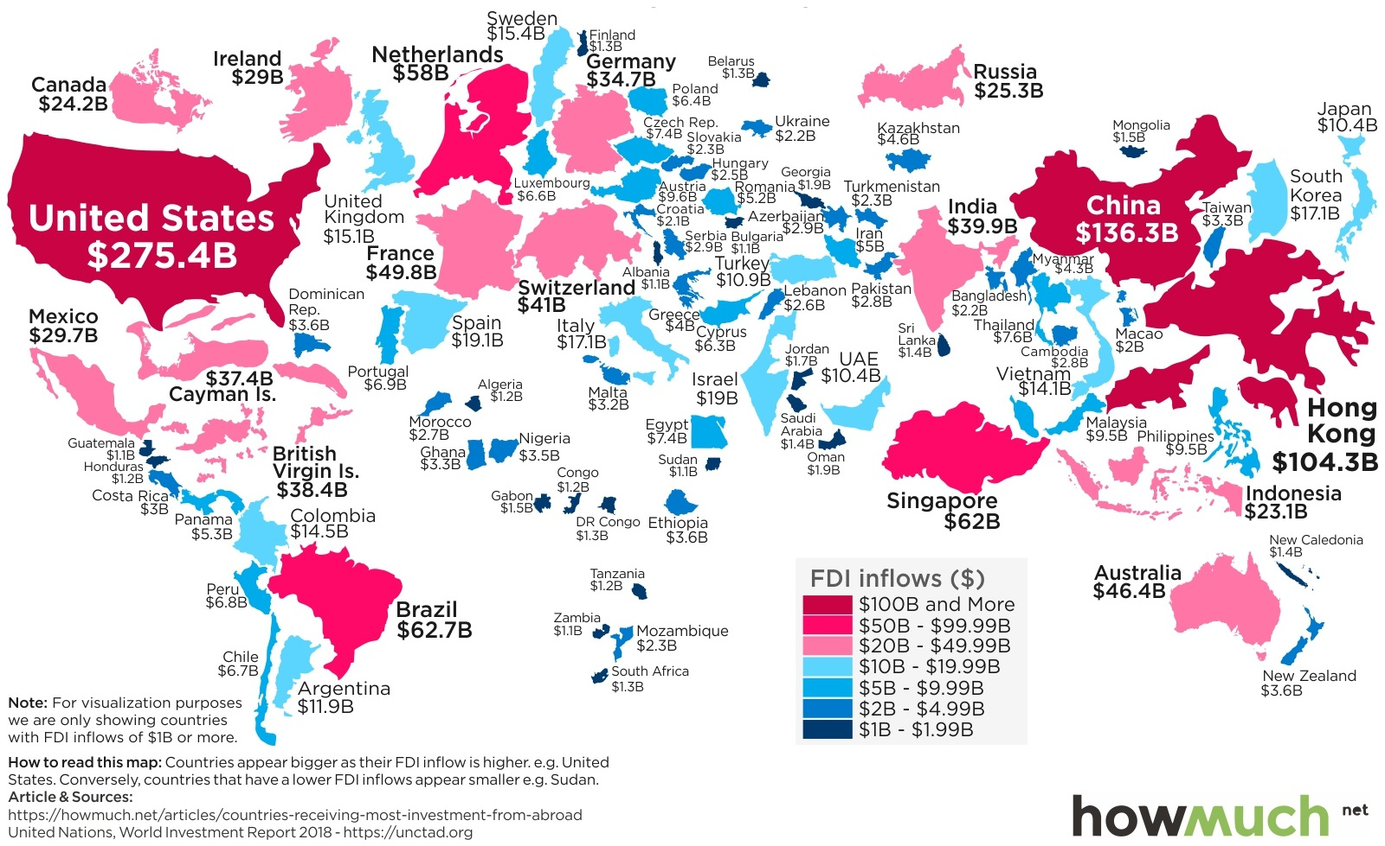
1.2 FDI Evidence – Global view

Slide 9
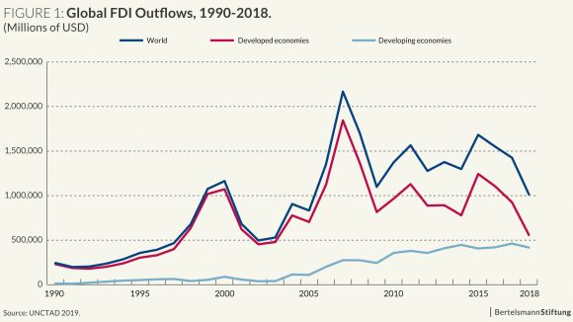
Ie where the money comes from
1.2.1 FDI Evidence

Slide 10
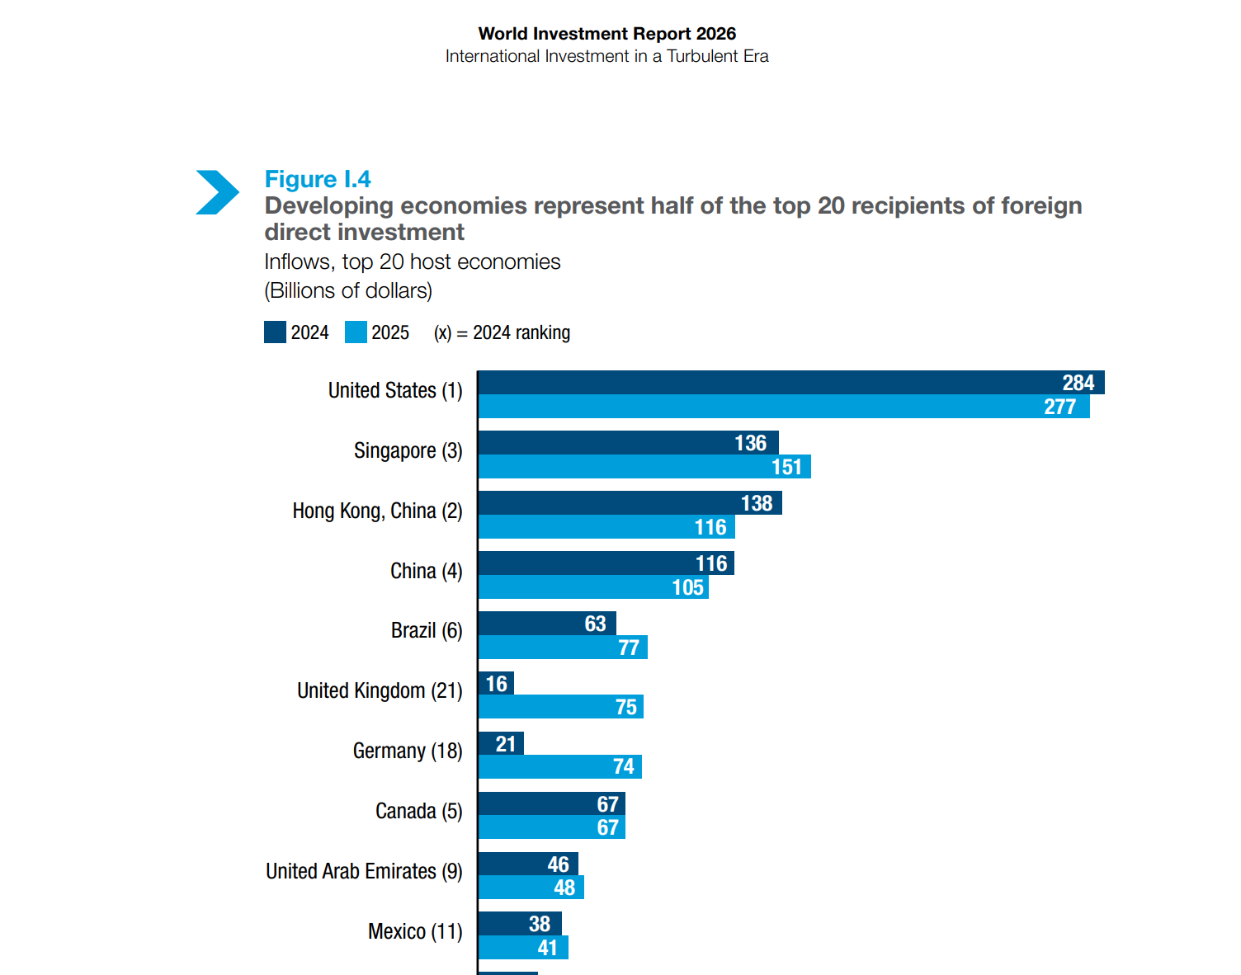
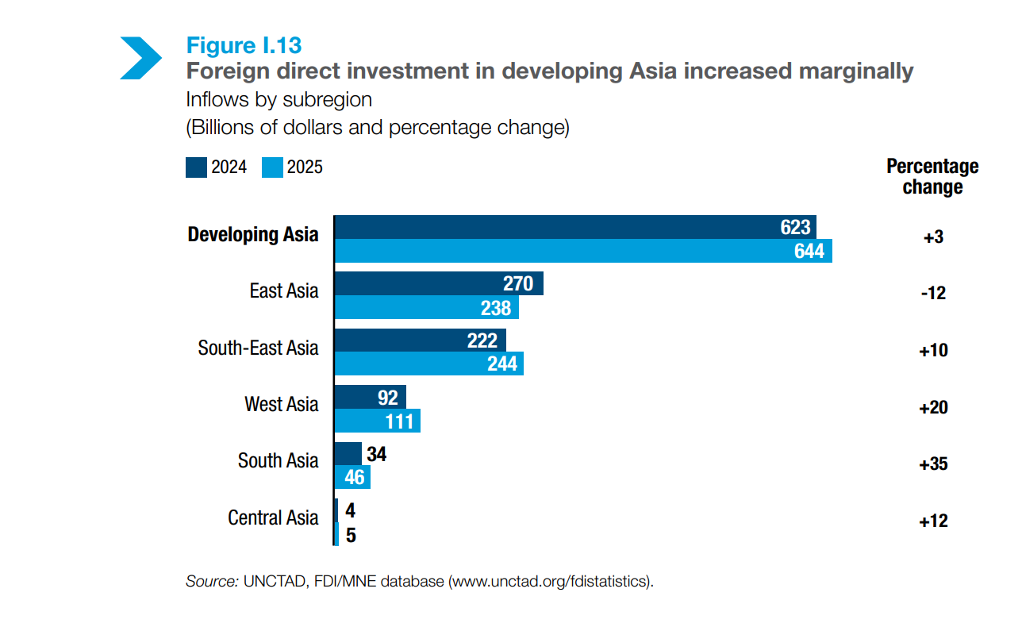
1.2.2 FDI evidence (Post Covid)
Video link : https://unctad.org/publication/world-investment-report-2026-international-investment-turbulent-era

Slide 11
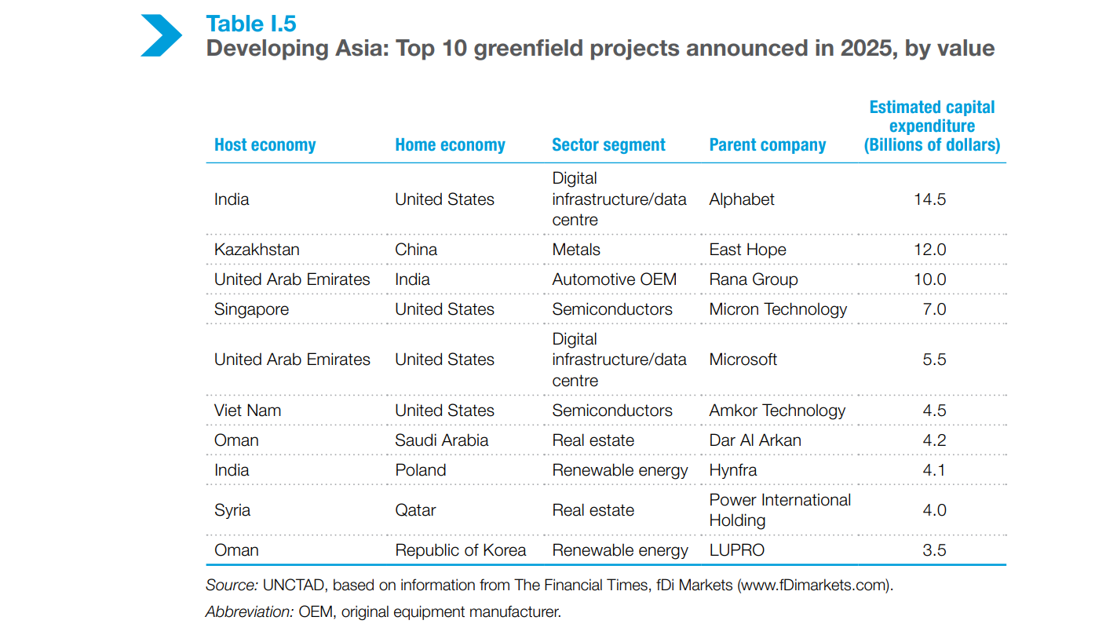
1.2.3 FDI Evidence : ASIA

Slide 12

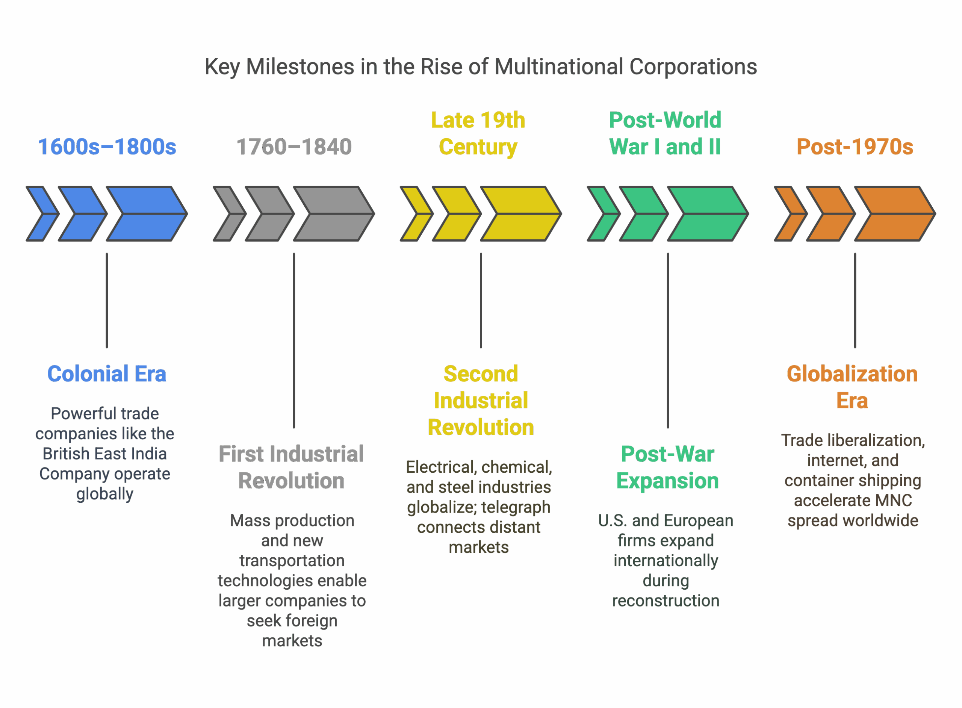
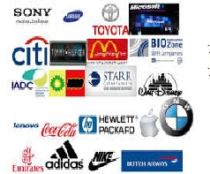
1.3 Foreign Direct Investment explained
This foreign firm/entity is usually referred as the
Multinational enterprise (MNE) or MNC
New terminology : The global company

Slide 13
1.4 Notable MNCs and FDIs into Asia
Technology & Electronics:
Apple: (e.g., Foxconn, Pegatron in China, Vietnam, India) for iPhone and other device assembly
Microsoft: Investments in data centers, cloud services (Azure), and software development hubs across key Asian cities.
Google: Similar to Microsoft, investing heavily in data centers and R&D facilities.
Automotive:
Volkswagen, General Motors, : These global automotive giants have established extensive manufacturing plants, R&D centers, and sales networks across various Asian markets (China, India, Thailand, Indonesia, Vietnam) to serve both local and export markets.
Intel: Major semiconductor manufacturing and R&D facilities, especially in countries like Vietnam, Malaysia, and China.

Slide 14
1.6 Notable MNCs and FDIs into Asia
Unilever, Procter & Gamble (P&G), Nestlé: These consumer giants have large manufacturing, distribution, and R&D operations throughout Asia to serve vast consumer bases.
Walmart, Carrefour, Tesco (though some have exited certain markets): Large retail chains have made significant investments in setting up retail networks and supply chain infrastructure.
H&M, Inditex (Zara): Major fashion retailers with extensive sourcing and some manufacturing presence.
Consumer Goods & Retail:

Slide 15
1.6 Notable MNCs and FDIs into Asia
Financial Services:
Major global banks like HSBC, Standard Chartered, Citi, JP Morgan Chase, Deutsche Bank have long-standing and substantial operations in financial hubs like Singapore, Hong Kong, Tokyo, and increasingly in emerging Asian markets, supporting cross-border trade and investment.
Oil & Gas / Energy:
ExxonMobil, Shell, BP, TotalEnergies, Chevron: These energy majors have significant upstream (exploration & production) and downstream (refining, petrochemicals, retail) investments across the region, from the Middle East to Southeast Asia.

Slide 16
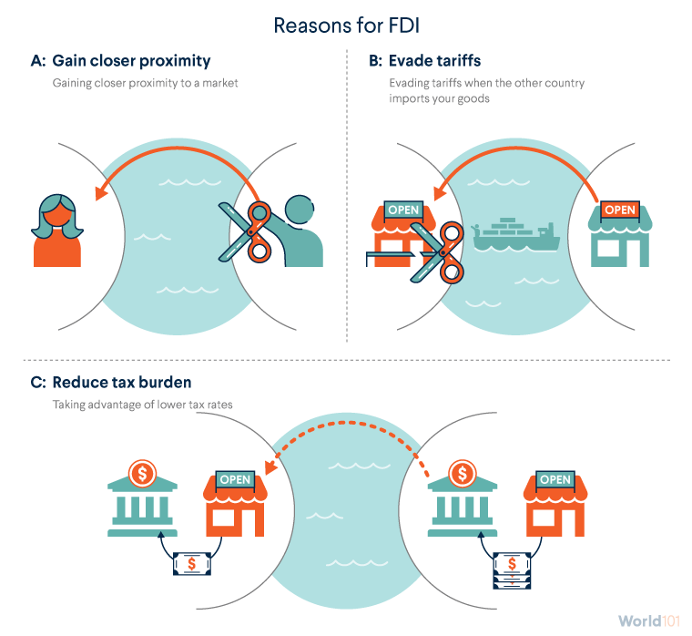
1.7 Reasons for FDI – Firm’s Perspectives Why are the possible reasons for firms to operate overseas?

Slide 17
1.7.1 Factors driving FDI – Firm’s Perspectives Why are the possible reasons for firms to operate overseas?
Profit = total revenue – total cost
Location
Lower Costs (Supply-Side Factors)
Firms choose to invest overseas to engage in resource-seeking or efficiency-seeking FDI.
Access to Raw Materials: Operating directly in host countries with abundant natural resources eliminates cross-border trade friction, secures supply chains, and reduces raw material procurement costs.
Cheaper and Larger Labour Pool: By shifting production to countries with a high supply of low-cost labor, firms lower their marginal production costs. This enhances global price competitiveness.
Recap the data you extracted or processed in Data analysis 01, which data series is relevant to drive FDI
Notes:
Level of N
Size of labour force, employment rate
Level of H

Slide 18
1.7.2 Reasons for FDI – Firm’s Perspectives Why are the possible reasons for firms to operate overseas?
Profit = total revenue – total cost
Location
Higher Revenues (Demand-Side Factors)
Firms invest overseas to engage in market-seeking FDI, expanding their top-line revenue growth.
Large Domestic Host Market: Accessing a vast new domestic consumer base allows firms to bypass import tariffs, avoid high international shipping fees, and scale operations rapidly.
Proximity to Consumers: Being physically closer to the target market reduces lead times. It allows firms to gather immediate market intelligence, respond swiftly to changing local preferences, and offer highly customized products
Recap the data you extracted or processed in Data analysis 01, which data series is relevant to drive FDI
Notes:
GDP growth rate
Household spending
Export growth
Regional trade pacts

Slide 19
1.7.2 Reasons for FDI – Firm’s Perspectives
1. Political and Economic Stability: Investors avoid high-risk environments. Predictable governance, low corruption, and internal security drastically lower the perceived risk of asset expropriation or sudden policy reversals.
2. Openness to Trade and Investment: Low tariff barriers, favorable foreign ownership limits, and a lack of restrictive capital controls make it easier for foreign firms to repatriate profits and import necessary raw materials or components.
3. Tax Incentives and Subsidies: Many developing nations offer corporate tax holidays, special economic zone (SEZ) benefits, or custom duty exemptions to lure high-value industries like semiconductors or green energy manufacturing.
4. Legal and Regulatory Protection: A transparent legal system, reliable enforcement of contracts, and strong intellectual property (IP) rights give foreign investors the confidence that their technology and capital are legally protected.
5. Exchange Rate stability : A stable and convertible currency minimizes foreign exchange risk, ensuring that local profits do not lose significant value when converted back to the multinational’s home currency.
Govt/ National Investment policy
Recap the data you extracted or processed in Data analysis 01, which data series is relevant to drive FDI
We will also access the UNCTAD in tutorial 03 to gather info on the discussed factors
Video link : Myanmar’s FDI bleak future :https://youtu.be/Vr5ZOdPvIKg

Slide 20
1.8 FDI and effects on hosting countries
Employment
Wages
Labour Productivity
Labour market
R&D
Networks
Knowledge
Reputation
Spillovers
Growth in Manufacturing
Sector
Economic Growth
Imagine a small town where a foreign investor sets up a factory. This factory doesn’t just produce goods; it also creates jobs, builds roads, trains workers, and transforms the town into a bustling hub of activity. This is the essence of policy on Foreign Direct Investment (FDI) a catalyst for economic development and progress

Slide 21

1.9 Possible harms of FDI
Exploitation of resources
Threat to environment
Threats to local smaller firms competition for resources and market
No loyalty and thus can create a hollow in the economy

Slide 22
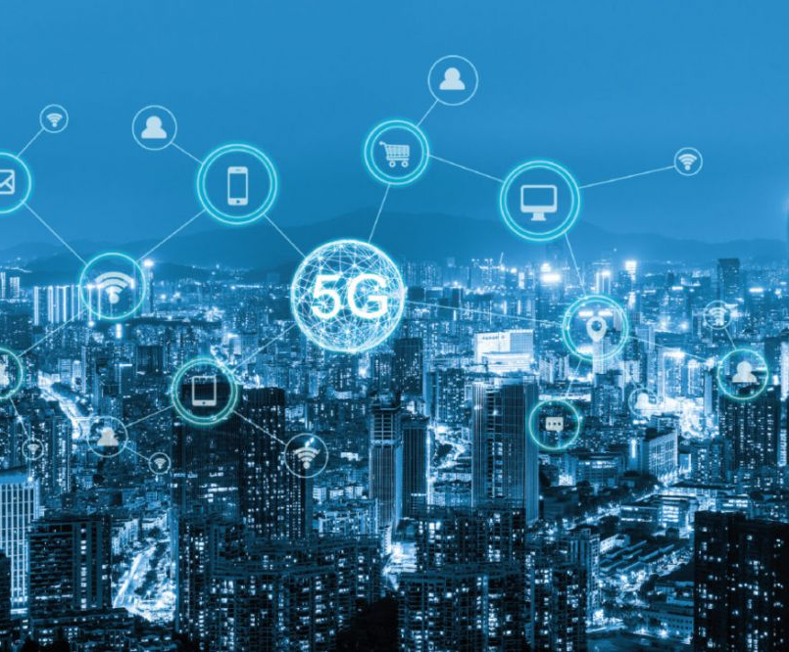

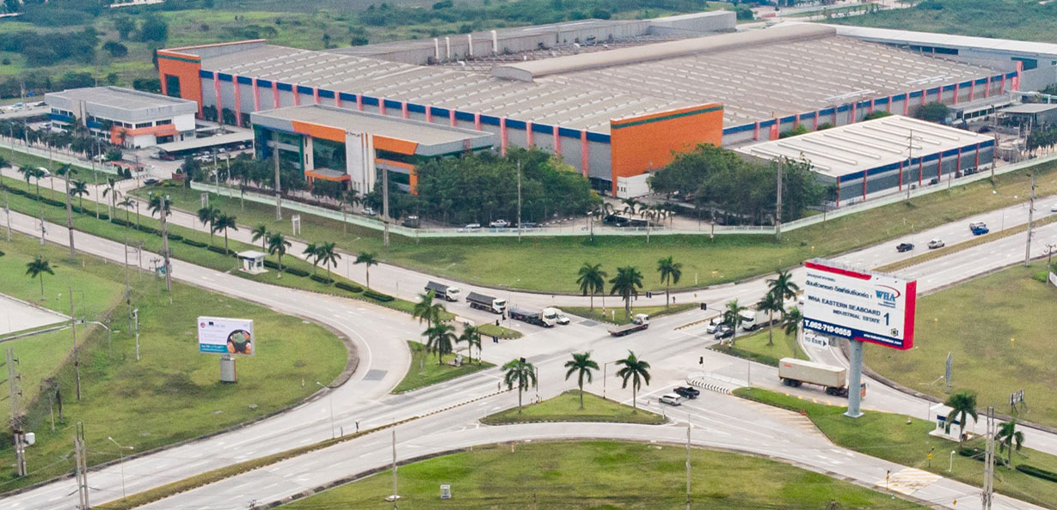
1.10 Government and attracting FDI
Bearing in mind the MNEs are keeping a look out for opportunities to quickly locate to produce for new and/or expanded markets
What can government prepare to lure and retain them ?
Video link : until 2:00
https://www.worldbank.org/en/news/video/2016/09/27/investment-policy-and-promotion

Slide 23
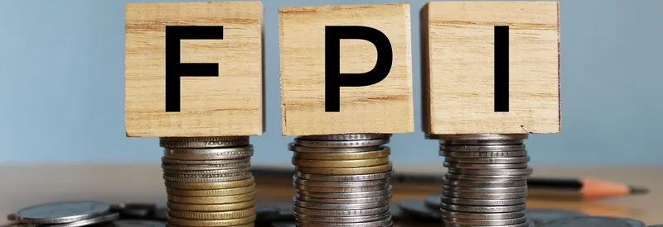
Foreign Portfolio Investment
Part II

Slide 24

2.1 Capital flow and economic growth
Harrod Domar Model
g = s/ v
Where
g = economic growth rate
S = national savings rate = level of funding
V = capital - output ratio [= K/Y]
A higher g is generated by a higher level of savings rate and/or a lower level of v [where Y rise faster than K = higher productivity]
This Photo by Unknown Author is licensed under CC BY-NC

Slide 25
2.2 Positive Effects of FPI
Inflow from Overseas
FPI
Financial Mkt : banks, stock market)
Lend to firms/ Govt
Increase K and larger rise in Y, v falls
Increase g and Labour productivity
Increase s
Liberalisation of financial mkt

Slide 26

2.2 Adverse Effects of FPI
Inflow from Overseas
FPI
Financial Mkt : banks, stock market)
Increase s
Lend to firms/ Govt
greater availability of funds and
LOW INTEREST RATES
= overheated assets market
Debt rises

Slide 27

2.3 Long term Financial market correction
Inflow from Overseas
FPI
Govt tighten financial market
Limit flow of funds raise interest rates
Financial Mkt : banks, stock market)
Increase s
Lend to firms/ Govt
Cheaper , greater availability of funds
= overheated assets market
Debt rises

Slide 28
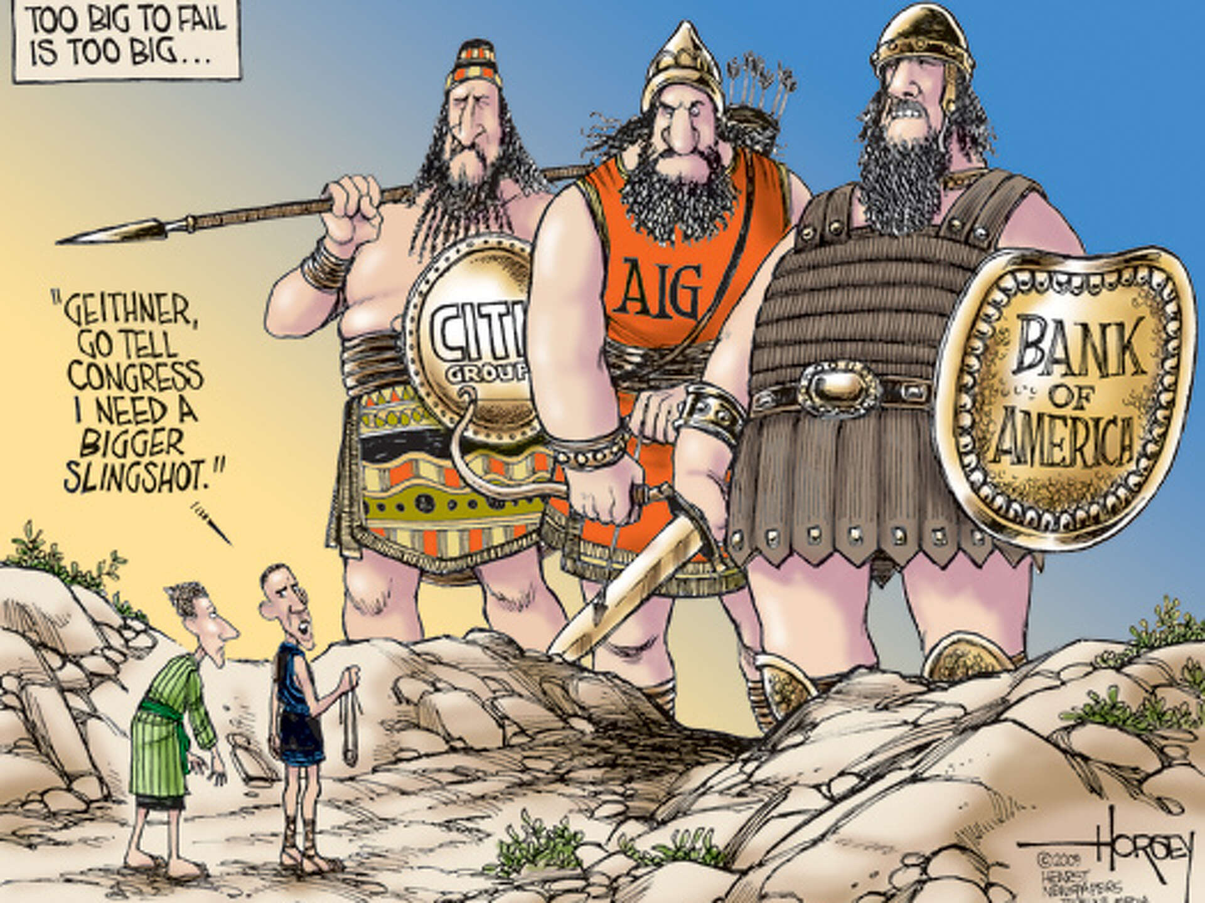

2.4 Financial Crisis
Japan bubble burst
1990
Asian Financial crisis
1997
Global Financial Crisis
Overheated Asset market
Start of Japan lost decade
Hot money trap
East Asia
2008
Unregulated financial innovation
Lehman brothers

Slide 29

2.5 Managing FPI risks
Besides a financial crisis, the govt is also wary of FPI being used as a disguise for money laundering (ML), terrorism financing (TF), and proliferation financing (PF).
To reduce the risk, the government works with the central bank on a coordinated approach of :
Capital controls,
Market monitoring, and
Reserve accumulation to prevent sudden capital flight and currency volatility.
Later in our examination of Asian economies, you will be able to examine certain policies they undertake with the intention to attract more FDI/FPI and also safeguard their domestic economies

Slide 30
Email : ckon@uow.edu.au
Send me an email if you have any issues or concerns on
The lesson today
Access to Moodle
Any errors you spotted in the course materials
Sharing a news or video resource
I will respond to you within 48 hours.

